Slide 1
GMR Institute of Technology

Slide 2
A REVIEW ON
E-VOTING SYSTEM

Slide 3
PROBLEM STATEMENT
Many problems are faced by the people in voting manually:
1.Much time is required
2.In some cases booth capturing is also happening so by this project we can reduce the chances of conflicts and also time for counting and many others

Slide 4
INTRODUCTION
Computer and internet are the most brilliant gift of the science. It provides a better way of communication and interaction .As we all know that in present world every thing based on internet so why not Online voting system
E-voting system project is implemented in java platform using My sql database as back end. Main aim of online voting system is to develop an online application like online reservation system, for citizen who are above 18 years of age to vote through online. Using these system citizens of India can vote through online without visiting polling booth. A centralized database is maintained where citizens information is maintained when ever citizen is using online voting system his/her information is authenticated with the data present in database if user is not in the list he cannot use e-voting system.

Slide 5
PURPOSE
In this present world of technology it is required to construct a way to conduct the election through internet.
This project is contribution to the from our side which becomes possible that our Election commission can help people in a better way.

Slide 6
Advantages
Time saving.
Working load reduced .
Information available at time .
It provide security for data.

Slide 7
OBJECTIVE
The main objective is to promote online voting system
And check out the results after elections
To deliver the information about elections
To deliver information about different political parties and their leaders
We live in a democracy and voting is one of our fundamental duties as responsible citizens of the country, but nowhere around the country a 100% people come to vote during the elections in their territory (country).

Slide 8
REQUIREMENTS
1.Hardware requiremnts:
Modem
Minimum 1GB RAM
Better performance with 2.10ghz and above cache memory
Minimum 50MB hard disk
2.Software requirements:
Operating system-windows10
Development platform-java
Browser-Google chrome

Slide 9
J Button
The JButton class is used to create a labelled button that has platform independent implementation. The application result in some action when the button is pushed. It inherits Abstract Button class.
JButton class declaration:
Let's see the declaration for javax.swing.JButton class.
public class JButton extends AbstractButton implements Accessible

Slide 10
J Panel
The JPanel is a simplest container class. It provides space in which an application can attach any other component. It inherits the JComponents class.
It doesn't have title bar.
JPanel class declaration:
public class JPanel extends JComponent implements
Accessible

Slide 11
Java ActionListener Interface
The Java ActionListener is notified whenever you click on the button or menu item. It is notified against ActionEvent.
The ActionListener interface is found in java.awt.event package.
It has only one method: actionPerformed().
public abstract void actionPerformed(ActionEvent e);

Slide 12
SCOPE
As this project provides a better way for election between people and political parties
As the population also increasing day by da our project will have great scope in future

Slide 13
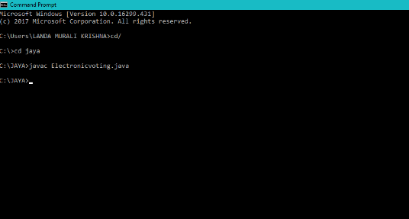
Result

Slide 14
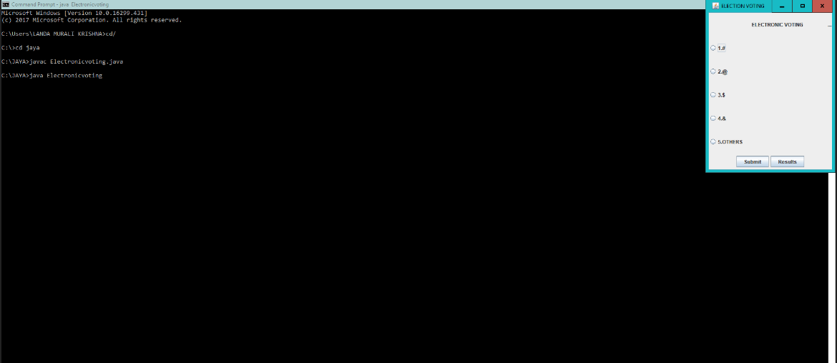
Result

Slide 15
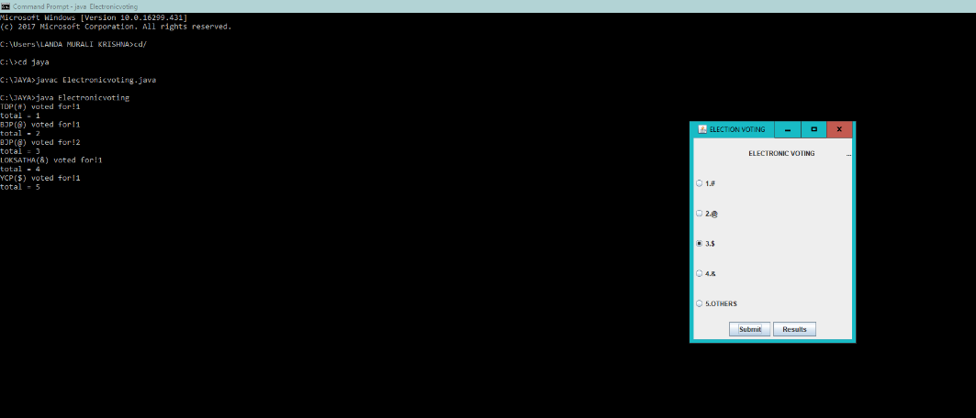
Result

Slide 16
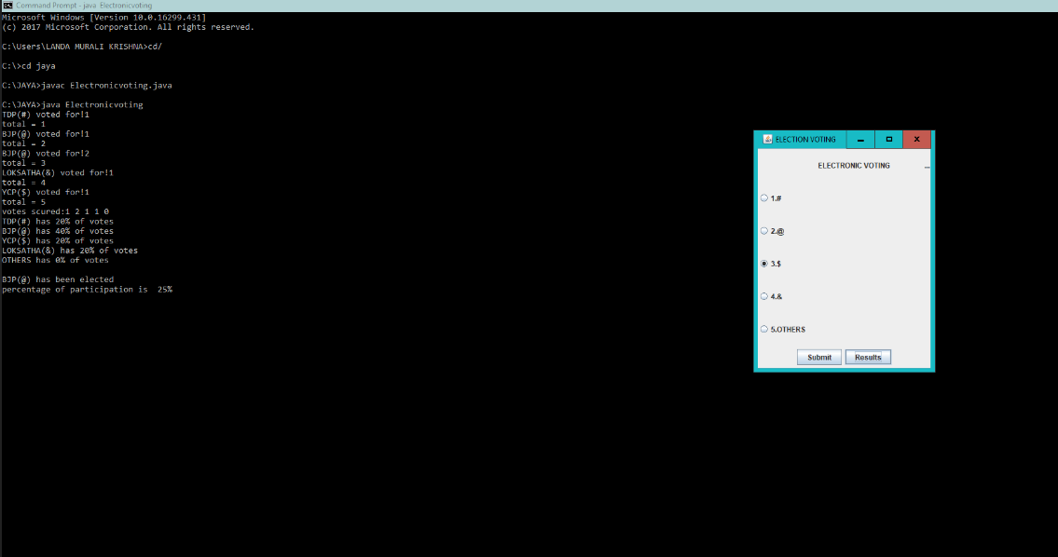
Result

Slide 17
conclusion
Generally voting has to be perform by user by going to the voting center. Many users like army person or NRI cannot come to voting place.
Therefore by which we have to implement online voting system by which the can vote through online. It is one of the greatest advantage for NRI and the people outside the country they can vote on online by our software.

Slide 18
THANK YOU

